Slide 1
Agenda
The Growth of Data and Definition of Big Data
Handling Data with Large Volume
Handling Data of Different Types
Audio
Graph
Sensor
Text
Point Cloud
Handling Streaming Data
Pitfalls of AI and Data Analysis

Slide 2
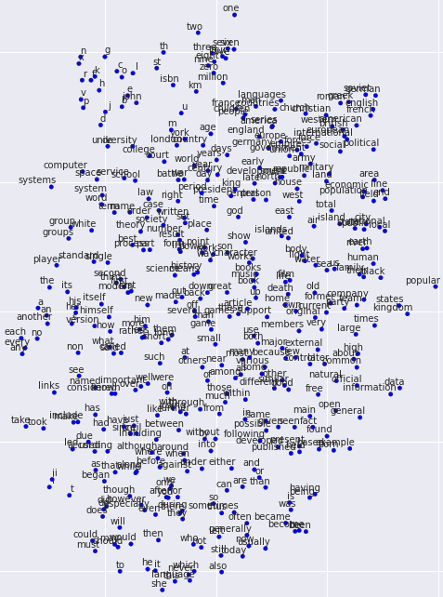
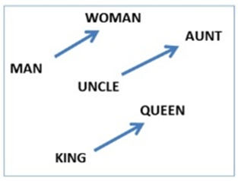
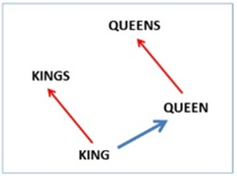
Word2Vec
Algebraic relations:
vec(‘‘woman")−vec(‘‘man") ≃ vec(‘‘aunt")−vec(‘‘uncle")
vec(‘‘woman")−vec(‘‘man") ≃ vec(‘‘queen")−vec(‘‘king")

Slide 3
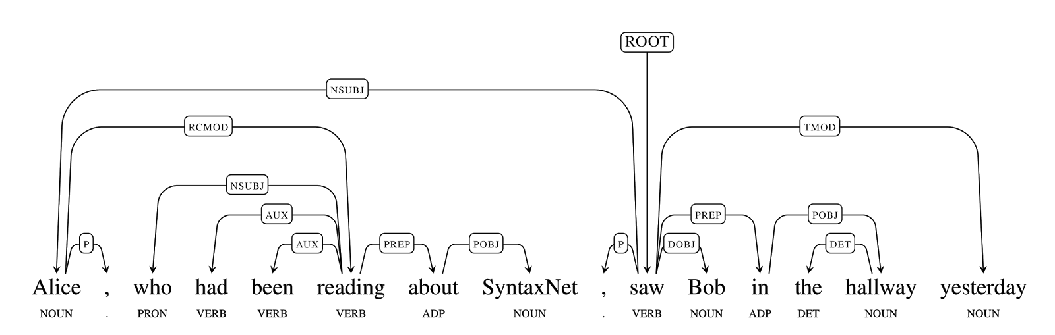
Natural Language Processing
SyntaxNet determines the syntactic relationships between words in a sentence with 94% accuracy (Human average accuracy is 96%).
Source: SyntaxNet

Slide 4
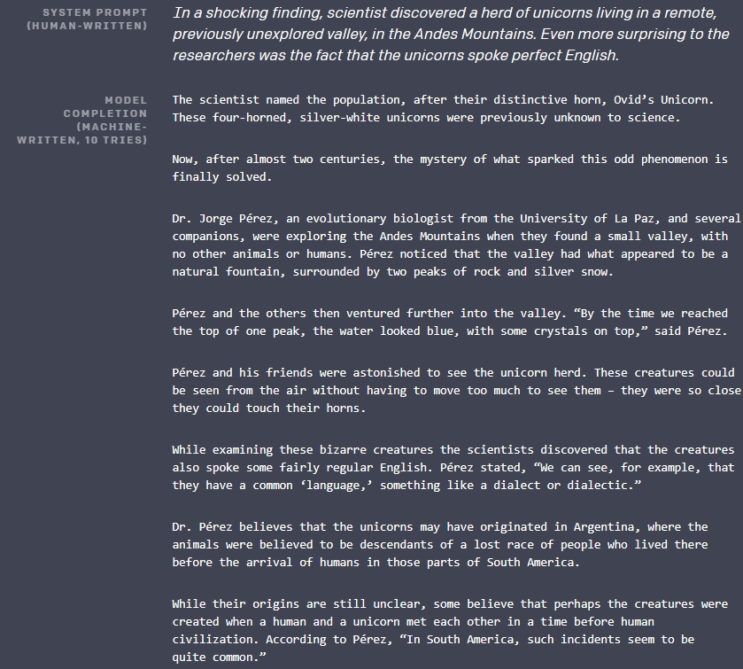
Automatic Text Generation
Source: GPT2

Slide 5

Automatic Medical Note Generation
Work done by Ivan Makohon @ NSWC DNA

Slide 6
Agenda
The Growth of Data and Definition of Big Data
Handling Data with Large Volume
Handling Data of Different Types
Audio
Graph
Sensor
Text
Point Cloud
Handling Streaming Data
Pitfalls of AI and Data Analysis

Slide 7
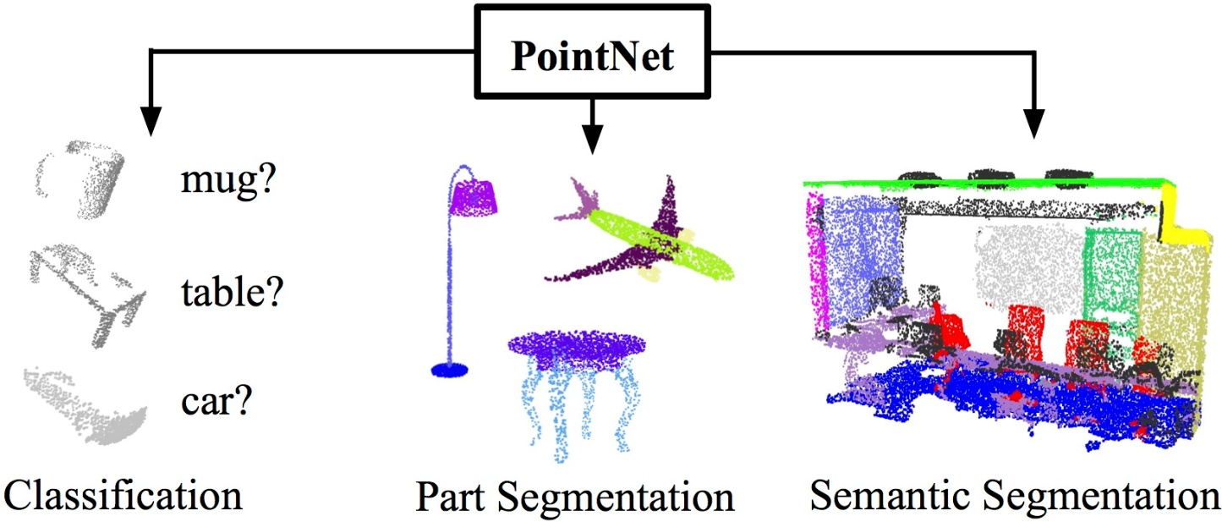
Point Cloud
PointNet can learn global and local point features from point cloud and support 3D object recognition tasks.
Source: PointNet

Slide 8

Generative Models for Point Cloud
Source: Latent 3D Point Cloud

Slide 9
Agenda
The Growth of Data and Definition of Big Data
Handling Data with Large Volume
Handling Data of Different Types
Audio
Graph
Sensor
Text
Point Cloud
Handling Streaming Data
Pitfalls of AI and Data Analysis

Slide 10
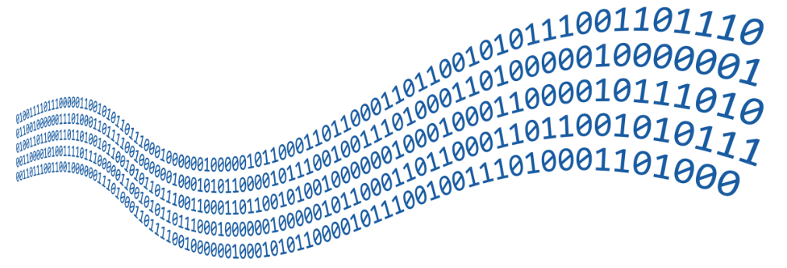
Streaming Data
Streaming Data
Continuous input
Streaming Data Applications
Notification and Alerting
Trigger a notification if some sort of event or event series occurs
Real-Time Reporting
Report real-time analysis
Online Machine Learning
Incremental features learning
Real-Time Decision Making
Fraud detection
Intrusion detection

Slide 11
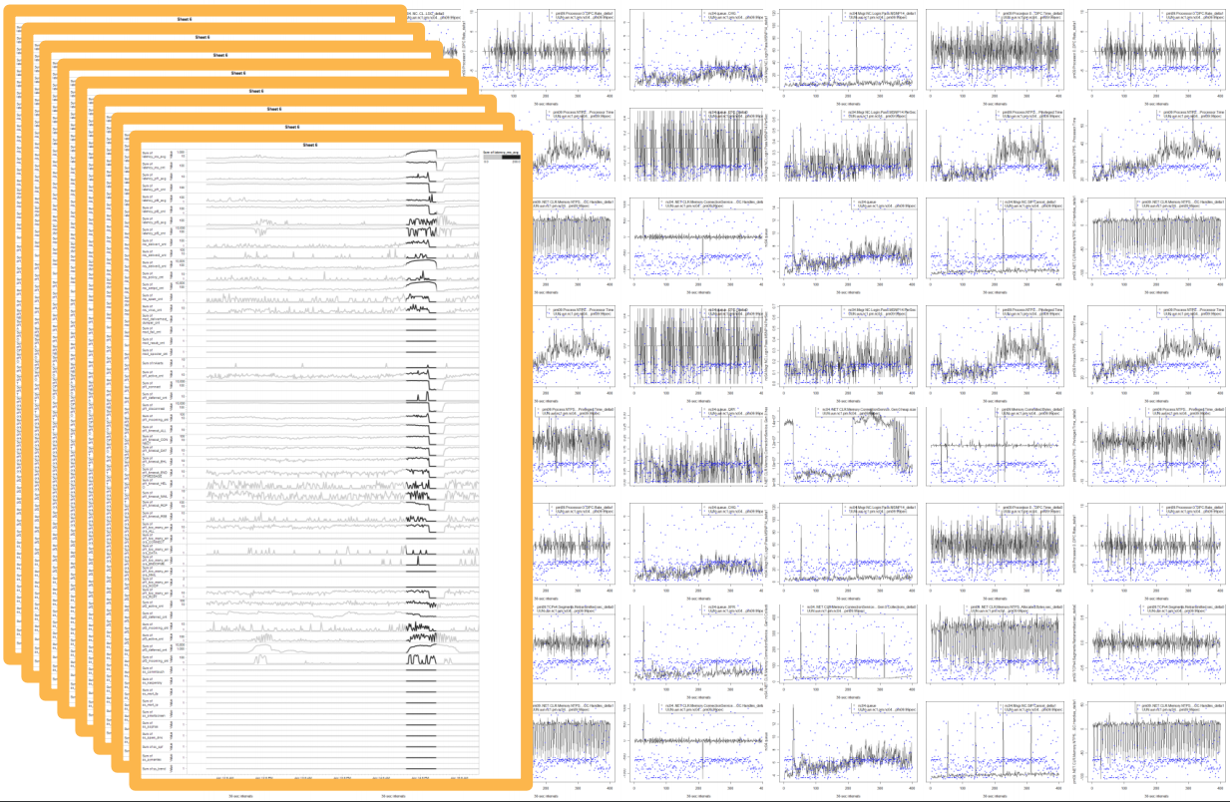
Streaming Sensor Data

Slide 12
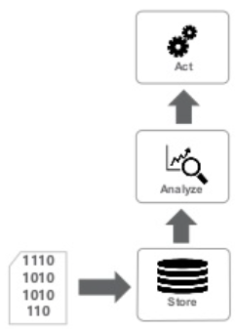
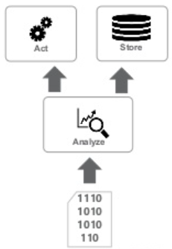
Streaming Data
Data at rest
vs
Data in motion

Slide 13
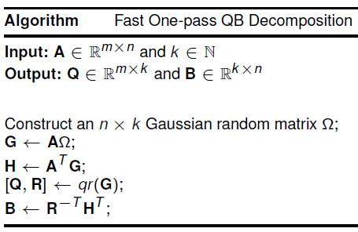
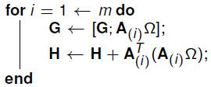
Pass Efficiency
Capture data pattern with only one pass
W. Yu, Y. Gu, Yaohang Li, "Efficient Randomized Algorithms for the Fixed-Precision Low-Rank Matrix Approximation," SIAM Journal on Matrix Analysis and Applications, 39(3): 1339-1359, 2018.

Slide 14
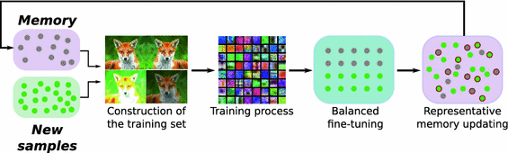
Incremental Machine Learning on Streaming Data
Distillation allows deep learning models to learn from new samples incrementally while keeping the knowledge from the old training data.
Castro F.M., Marín-Jiménez M.J., Guil N., Schmid C., Alahari K. (2018) End-to-End Incremental Learning. In: Ferrari V., Hebert M., Sminchisescu C., Weiss Y. (eds) Computer Vision – ECCV 2018. ECCV 2018.

Slide 15
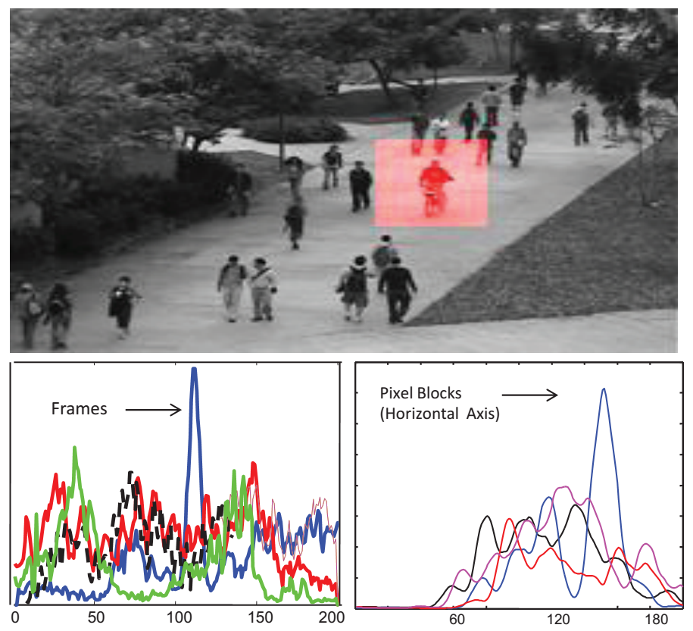
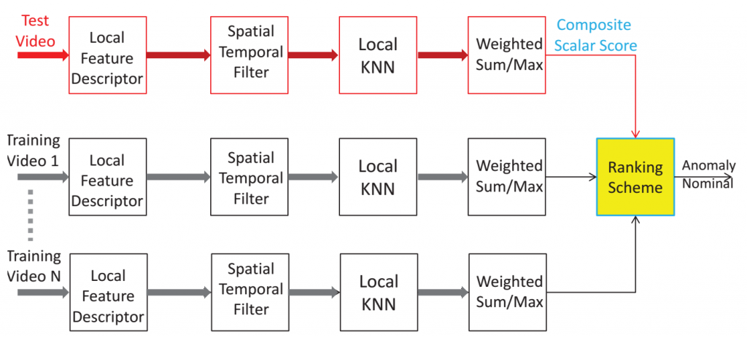
Anomaly Detection in Video Surveillance Stream
V. Saligrama, Z. Chen, Video Anomaly Detection Based on Local Statistical Aggregates, CVPR 2012

Slide 16
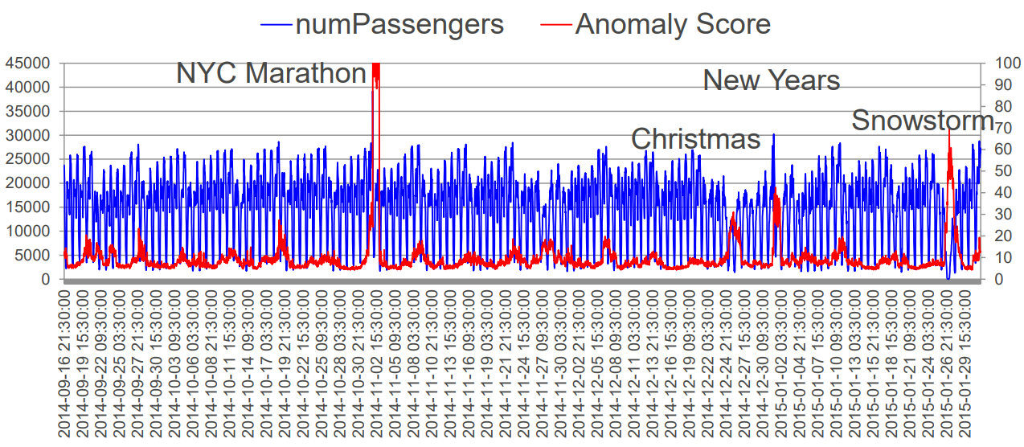
Anomaly Mining on Streaming Data
Analyzing the anomaly score reveals the causes of anomalies.
Guha, S., Mishra, N., Roy, G., & Schrijvers, O. (2016). Robust random cut forest based anomaly detection on streams. In International conference on machine learning (pp. 2712-2721).

Slide 17
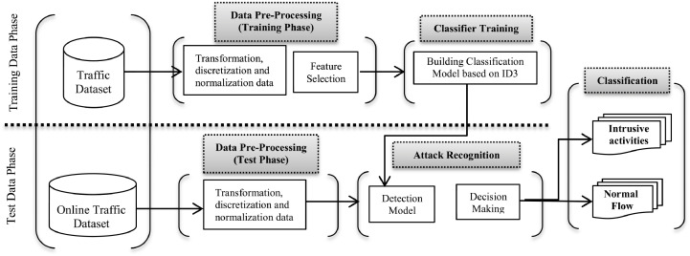
Intrusion Detection on Network Traffic Stream
KDD 99 Dataset
DOS: denial-of-service, e.g. syn flood;
R2L: unauthorized access from a remote machine, e.g. guessing password;
U2R: unauthorized access to local superuser (root) privileges, e.g., various “buffer overflow” attacks;
probing: surveillance and other probing, e.g., port scanning.
Sara Mohammadi, Hamid Mirvaziri, Mostafa Ghazizadeh-Ahsaee, Hadis Karimipour,
Cyber intrusion detection by combined feature selection algorithm, Journal of Information Security and Applications, 44: 80-88, 2019.

Slide 18
Agenda
The Growth of Data and Definition of Big Data
Handling Data with Large Volume
Handling Data of Different Types
Audio
Graph
Sensor
Text
Point Cloud
Handling Streaming Data
Pitfalls of AI and Data Analysis

Slide 19
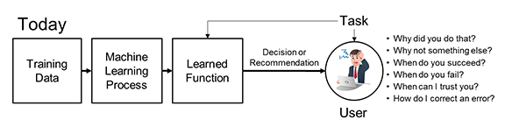
Pitfalls and Risk of AI and Data Analysis
Pitfalls and Risk of AI
AI systems can be fooled
Deep learning algorithms are far away from “explainable”
Poor quality of data
Good information to make good decisions
Uncertainty
Solutions
Explainable deep learning
Uncertainty quantification

Slide 20

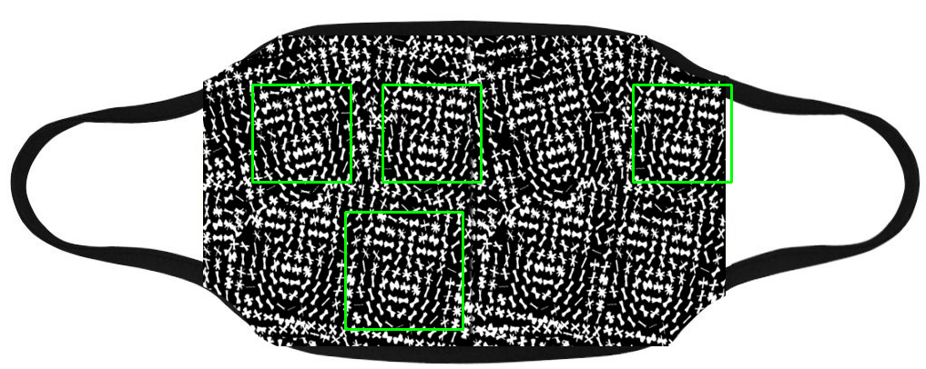
Fooling the Facial Recognition Systems
A face recognition system can be fooled by 3D printed face mask, a picture, or even a mask with patterns.

Slide 21
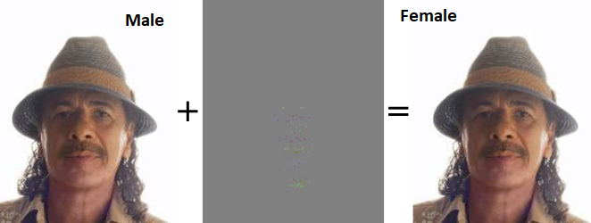
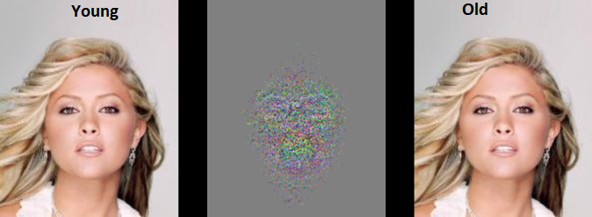
Adversarial Attacks by Attribute Flipping
Adversarial examples generated by fast flipping attribute (FFA) technique by adding small, non-random perturbations to original inputs.
The modifications remain imperceptible to human observers.
Machine learning models are vulnerable to classify the original and adversarial example.
Are Facial Attributes Adversarially Robust? arXiv:1605.05411
Andras Rozsa, Manuel Günther, Ethan M. Rudd, Terrance E. Boult

Slide 22
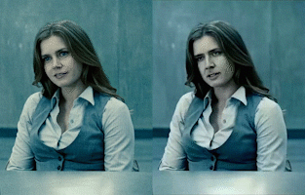

Synthetic Media
Nicolas Cage as Lois Lane
Mr. Bean as Lois Lane and Superman
DeepFake: Replace a person in an existing image or video with someone else's likeness
Image Source: DeepFake

Slide 23

Fake News Generator
notrealnews.net

Slide 24
Data Quality
Machine Learning has a single point of failure – Bad Data
Common data quality problems
Data sparsity
Data corruption
Irrelevant data
Bad labeling
Unbalanced data
Missing data
Learning wrong patterns
…

Slide 25

Flower Classification Project

Slide 26
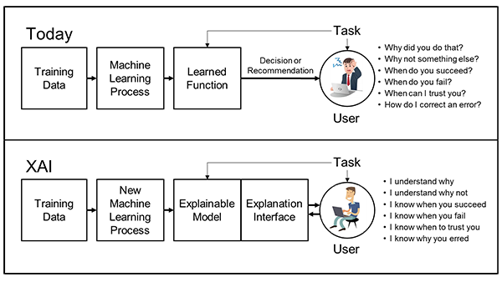
Explainable AI (XAI)
Explainable models, while maintaining a high level of learning performance (prediction accuracy)
Enable human users to understand, appropriately trust, and effectively manage the emerging generation of artificially intelligent partners.
Image Source: DARPA

Slide 27
Schedule of the Seminar Series
21 May: Introduction to Artificial Intelligence and Data Analysis
28 May: Regression Models
04 June: Classification Methods
11 June: Feature Engineering
18 June: Neural Network and Deep Learning
25 June: Unsupervised Learning
02 July: Generative Adversarial Networks
09 July: Recommender System
16 July: Natural Language Processing
23 July: Time Series Analysis

Slide 28
Summary
3V and 5V Definition of Big Data
Handling Large-Volume of Data
Handling Streaming Data
Handling Data of Different Types
AI and Data Analysis have Pitfalls and Risk
Explainable AI is the key

